Slide 1
Medical Image Analysis: Multivariate Mixture Model for Myocardial Segmentation Combining Multi-Source Images
Xinzhe Luo
School of Data Science, Fudan University

Slide 2
Contents
Introduction & Motivation
Combined segmentation for multi-source images
Simultaneous registration and segmentation
Multivariate mixture model
Problem formulation and representation
Expectation-maximization algorithm
Spatial regularization
Hetero-coverage multi-modality images
Experiment and demonstration
Conclusion

Slide 3
Introduction
Multi-modality medical images
Notes:
多模态图像:
1. 不同图像是commonspace anatomy的表象
2. 不同模态图像反映不同的结构信息

Slide 4
Motivation
Myocardial infarction identification from LGE CMR
Automatic myocardial segmentation from LGE CMR
Combined segmentation for multi-source images
Simultaneous registration and segmentation

Slide 5
Contents
Introduction & Motivation
Combined segmentation for multi-source images
Simultaneous registration and segmentation
Multivariate mixture model
Problem formulation and representation
Expectation-maximization algorithm
Spatial regularization
Hetero-coverage multi-modality images
Experiment and demonstration
Conclusion

Slide 6
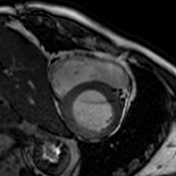
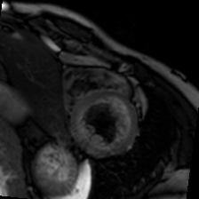
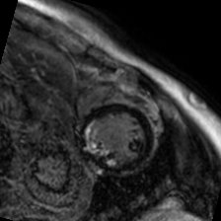
Multivariate mixture model
Notations:
Denote $I=\left\{I_{i} | i=1,…,N_{I}\right\}$ be a set of $N_{I}$ acquired from the same subject.
Denote $Ω$ as the common space, which is defined by the combination of images.
For a location $x∈Ω$, denote tissue types by labels, $s\left(x\right)=k$, $k∈K$, and the subtypes of a tissue $k$ in image $I_{i}$ as $z_{i}\left(x\right)=c$, $c∈C_{ik}$.

Slide 7
Multivariate mixture model
Likelihood function: $L\left(θ;I\right)=p\left(I | θ\right)$
Assuming all images are located in the common space
Assuming independence of each location, one gets $p\left(I | θ\right)=\prod_{x∈Ω}{p\left(I\left(x\right) | θ\right)}$
Assuming mixture model on label assignments, $p\left(I(x) | θ\right)=\sum_{k∈K}{π_{kx}⋅p\left(I\left(x\right) | s\left(x\right)=k,θ\right)}$ where $π_{kx}=p\left(s\left(x\right)=k | θ\right)$ is the label proportion.

Slide 8
Multivariate mixture model
Likelihood function: $L\left(θ;I\right)=\prod_{x∈Ω}{\sum_{k∈K}{π_{kx}⋅p\left(I\left(x\right) | s\left(x\right)=k,θ\right)}}$
Assuming conditional independence of intensities between different images: $p\left(I\left(x\right) | s\left(x\right)=k,θ\right)=\prod_{i=1}^{N_{I}}{p\left(I_{i}\left(x\right) | k_{x},θ\right)}$
Assuming Gaussian mixture model as the intensity distribution: $p\left(I_{i}\left(x\right) | k_{x},θ\right)=\sum_{c∈C_{ik}}{τ_{ikc}⋅Φ\left(I_{i}\left(x\right);μ_{ikc},σ_{ikc}^{2}\right)}$

Slide 9
Multivariate mixture model
Likelihood function: $L\left(θ;I\right)=\prod_{x∈Ω}{\sum_{k∈K}{π_{kx}\prod_{i=1}^{N_{I}}{\sum_{c∈C_{ik}}{τ_{ikc}⋅Φ\left(I_{i}\left(x\right);μ_{ikc},σ_{ikc}^{2}\right)}}}}$ where $θ=\left\{π_{kx},τ_{ikc},μ_{ikc},σ_{ikc}^{2}\right\}$ are model parameters.

Slide 10
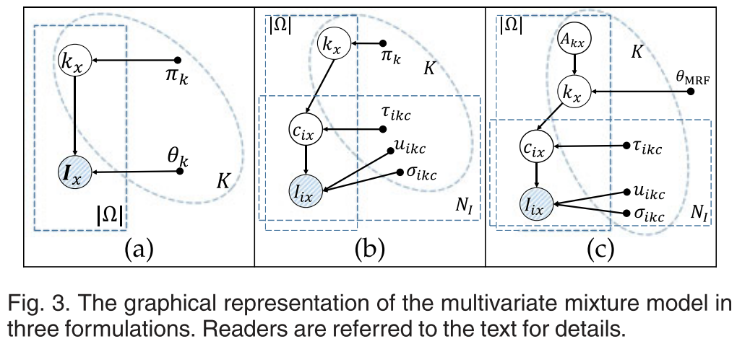
Multivariate mixture model
Graphical model:

Slide 11
Expectation-maximization algorithm
Objective:
Learning parameters of the model from the observed data
Data are considered as realizations of the generative model
Registration
Inference given the learned parameters
Segmentation
Representation
Segmentation
Registration
Inference
Learning

Slide 12
Expectation-maximization algorithm
Maximum likelihood estimator (MLE)
Log-likelihood: $ℓ\left(θ;I\right)=\sum_{x∈Ω}{\ln\left\{\sum_{k∈K}{π_{kx}\prod_{i=1}^{N_{I}}{\sum_{c∈C_{ik}}{τ_{ikc}⋅Φ\left(I_{i}\left(x\right);μ_{ikc},σ_{ikc}^{2}\right)}}}\right\}}$
Problems related to MLE:
Maximizing the log-likelihood is not a well posed problem because singularities will occur whenever one of the Gaussian components ‘collapses’ onto a specific data points when we have at least two components in the mixture
The presence of the summation over $k$ that appears inside the logarithm make maximization difficult

Slide 13
Expectation-maximization algorithm
E-step: compute posterior distribution of the latent variables $\left\{c_{ik}, k_{x}\right\}$ given the current estimate of the model parameters $θ^{\left[m\right]}$
Posterior of $k_{x}$: $P_{kx}^{\left[m+1\right]}≔p\left(s\left(x\right)=k | I;θ^{\left[m\right]}\right)$ $=\frac{p\left(I\left(x\right) | k_{x};θ^{\left[m\right]}\right)π_{kx}^{\left[m\right]}}{\sum_{l∈K}{p\left(I\left(x\right) | l_{x};θ^{\left[m\right]}\right)π_{lx}^{\left[m\right]}}}$
Posterior of $\left\{c_{ik},k_{x}\right\}$: $P_{ikcx}^{\left[m+1\right]}≔p\left(s\left(x\right)=k,z_{i}\left(x\right)=c_{ik} | I,θ^{\left[m\right]}\right)$ $=p\left(c_{ikx} | k_{x},I,θ^{\left[m\right]}\right)P_{kx}^{\left[m+1\right]}$ $=\frac{Φ\left(I_{i}\left(x\right);μ_{ikc}^{\left[m\right]},{\left(σ_{ikc}^{2}\right)}^{\left[m\right]}\right)τ_{ikc}^{\left[m\right]}}{p\left(I_{i}\left(x\right) | k_{x};θ^{\left[m\right]}\right)}P_{kx}^{\left[m+1\right]}$

Slide 14
Expectation-maximization algorithm
M-step: Maximize the expected complete-log-likelihood under the updated posterior distribution with respect to the model parameters
Log-likelihood (marginal): $\ln{p\left(I | θ\right)}=\sum_{x∈Ω}{\ln\left\{\sum_{k∈K}{π_{kx}\prod_{i=1}^{N_{I}}{\sum_{c∈C_{ik}}{τ_{ikc}⋅Φ\left(I_{i}\left(x\right);μ_{ikc},σ_{ikc}^{2}\right)}}}\right\}}$
Expected complete-log-likelihood (expected joint): $𝔼\left[\ln{p\left(I,Z,S | θ\right)}\right]$ $=\sum_{x∈Ω}{\left\{\sum_{k∈K}{P_{kx}^{\left[m+1\right]}\ln{π_{kx}}}+\sum_{k∈K}{\sum_{c∈C_{ik}}{P_{ikcx}^{\left[m+1\right]}\left(\ln{τ_{ikc}}+\ln{Φ\left(I_{i}\left(x\right);μ_{ikc},σ_{ikc}^{2}\right)}\right)}}\right\}}$

Slide 15
Expectation-maximization algorithm
Expected complete-log-likelihood (expected joint): $𝔼\left[\ln{p\left(I,Z,S | θ\right)}\right]$ $=\sum_{x∈Ω}{\left\{\sum_{k∈K}{P_{kx}^{\left[m+1\right]}\ln{π_{kx}}}+\sum_{k∈K}{\sum_{c∈C_{ik}}{P_{ikcx}^{\left[m+1\right]}\left(\ln{τ_{ikc}}+\ln{Φ\left(I_{i}\left(x\right);μ_{ikc},σ_{ikc}^{2}\right)}\right)}}\right\}}$
M-step: Maximizing $𝔼\left[\ln{p\left(I,Z,S | θ\right)}\right]$ with respect to $θ=\left\{π_{kx},τ_{ikc},μ_{ikc},σ_{ikc}^{2}\right\}$ gives $π_{kx}^{\left[m+1\right]}=P_{kx}^{\left[m+1\right]}$ and $π_{k}^{\left[m+1\right]}=\frac{\sum_{x∈Ω}{P_{kx}^{\left[m+1\right]}}}{\sum_{x∈Ω}{\sum_{k∈K}{P_{kx}^{\left[m+1\right]}}}}$ without spatial regularization $τ_{ikc}^{\left[m+1\right]}=\frac{\sum_{x∈Ω}{P_{ikcx}^{\left[m+1\right]}}}{\sum_{x∈Ω}{\sum_{c∈C_{ik}}{P_{ikcx}^{\left[m+1\right]}}}}$ $μ_{ikc}^{\left[m+1\right]}=\frac{\sum_{x∈Ω}{I_{i}\left(x\right)P_{ikcx}^{\left[m+1\right]}}}{\sum_{x∈Ω}{P_{ikcx}^{\left[m+1\right]}}}$ ${\left(σ_{ikc}^{2}\right)}^{\left[m+1\right]}=\frac{\sum_{x∈Ω}{{\left(I_{i}\left(x\right)−μ_{ikc}^{\left[m+1\right]}\right)}^{2}P_{ikcx}^{\left[m+1\right]}}}{\sum_{x∈Ω}{P_{ikcx}^{\left[m+1\right]}}}$

Slide 16
Spatial regularization
Motivation: Voxels with the same intensity distribution in medical images can come from different structures.
Probabilistic atlases: $π_{kx}∝π_{k}⋅p\left(A_{kx}\right)$ where $p\left(A_{kx}\right)=p_{A}\left(s\left(x\right)=k\right)$.

Slide 17
Spatial regularization
M-step with probabilistic atlas: Maximize $𝔼\left[\ln{p\left(I,Z,S | θ\right)}\right]$ with respect to the proportion parameters $\left\{π_{k}\right\}$: $𝔼\left[\ln{p\left(I,Z,S | θ\right)}\right]=\sum_{x∈Ω}{\sum_{k∈K}{P_{kx}^{\left[m+1\right]}\ln{π_{kx}}}}+const.$ where $\sum_{x∈Ω}{\sum_{k∈K}{P_{kx}^{\left[m+1\right]}\ln{π_{kx}}}}=\sum_{x∈Ω}{\sum_{k∈K}{P_{kx}^{\left[m+1\right]}\left[\ln{π_{k}p\left(A_{kx}\right)}−\ln{\sum_{j∈K}{π_{j}p\left(A_{jx}\right)}}\right]}}$
Setting its derivative w.r.t. to $π_{k}$ gives: $π_{k}=\frac{\sum_{x}{P_{kx}^{\left[m+1\right]}}}{\sum_{x}{\left(\frac{P\left(A_{kx}\right)}{\sum_{j∈K}{π_{j}p\left(A_{jx}\right)}}\right)}}$

Slide 18
Initialization
Parameters are initialized based on the atlas prior probabilities $π_{k}^{\left[0\right]}=\frac{\sum_{x}{p\left(A_{kx}\right)}}{\sum_{l∈K}{\sum_{x}{p\left(A_{lx}\right)}}}$ $τ_{ikc}^{\left[0\right]}=\frac{1}{\left|C_{ik}\right|}$ $μ_{ikc}^{\left[0\right]}=\left\{\begin{aligned}μ_{ik}^{\left[0\right]}+a σ_{ik}^{\left[0\right]}, |C_{ik}≥2| \\ μ_{ik}^{\left[0\right]}, |C_{ik}=1|\end{aligned}\right.$ ${\left(σ_{ikc}^{\left[0\right]}\right)}^{2}=\left|C_{ik}\right|{\left(σ_{ik}^{\left[0\right]}\right)}^{2}$ where $μ_{ik}^{\left[0\right]}=\frac{\sum_{x}{I_{i}\left(x\right)p\left(A_{kx}\right)}}{\sum_{x}{p\left(A_{kx}\right)}}$, and ${\left(σ_{ik}^{\left[0\right]}\right)}^{2}=\frac{\sum_{x}{{\left(I_{i}\left(x\right)−μ_{ik}^{\left[0\right]}\right)}^{2}p\left(A_{kx}\right)}}{\sum_{x}{p\left(A_{kx}\right)}}$

Slide 19
Generalized EM (GEM)
The M-step yields the same solution for the segmentation parameters $θ^{\left[m+1\right]}$ as in the case of the independent model
However, the M-step remains intractable for the MRF parameters $Φ$. Instead of aiming to maximize $ℒ\left(q,Θ\right)$ with respect to $Φ$, the GEM seeks to change the parameters in such a way as to increase its value.
Expectation conditional maximization (ECM) partitions the parameters into groups, and the M-step is broken down into multiple steps each of which involves optimizing one of the subset with the remainder held fixed.

Slide 20
Registration in MvMM
The motion shift of a slice against the common space.
The motion shift of a slice is modelled by a rigid transformation: $p\left(I_{i}\left(x\right) | c_{ik};θ,G_{i,s}\right)=Φ_{ikc}\left(I_{i}\left(G_{i,s}\left(x\right)\right)\right)$ where $\left\{G_{i,s}\right\}$ are the transformations for correcting slices.

Slide 21
Registration in MvMM
The misalignment of the atlas against the common space
Introduce the atlas deformation $D$ for correcting the mis-registration: $p_{A}\left(s\left(x\right)=k | D\right)=p_{A}\left(s\left(D\left(x\right)\right)=k\right)=A_{k}\left(D\left(x\right)\right), k=1,…,K$
For the independent model, the log-likelihood is reformulated as: $ℓ\left(θ,D,\left\{G_{i,s}\right\}\right)=\sum_{x∈Ω}{\ln\left\{\sum_{k∈K}{π_{kx|D}\prod_{i=1}^{N_{I}}{\sum_{c∈C_{ik}}{τ_{ikc}⋅Φ_{ikc}\left(I_{i}\left(G_{i,s}\left(x\right)\right)\right)}}}\right\}}$

Slide 22
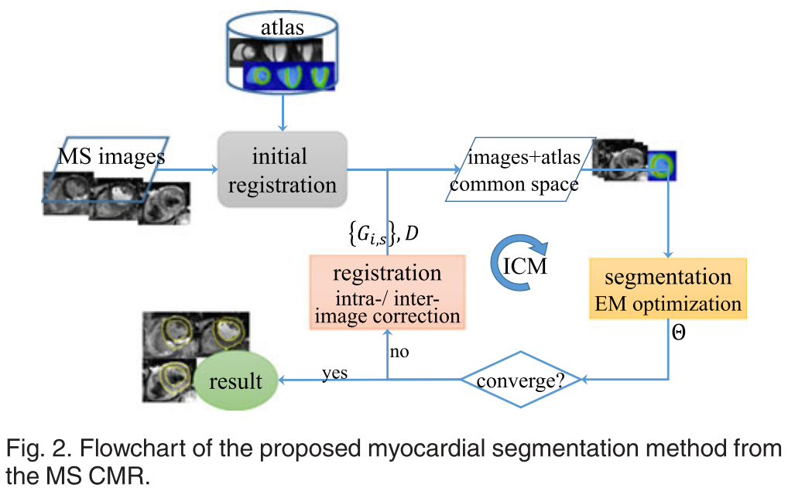
Iterative Conditional Mode (ICM)
$\text{ICM} \text{optimizes} \text{the} \text{segmentation} \text{and} \text{registration} \text{parameters} \text{alternately}$
$\text{Update} \text{segmentation} \text{parameters} θ \text{by} \text{EM} \text{algorithm}$
$\text{E}\text{−}\text{step}$
$\text{M}\text{−}\text{step}$
$\text{Update} \text{registration} \text{parameters} D,\left\{G_{i,s}\right\} \text{by} \text{gradient} \text{ascent} \text{of} \text{the} \text{log}\text{−}\text{likelihood}$
Notes:
注意M-step和registration update的objective function不同

Slide 23
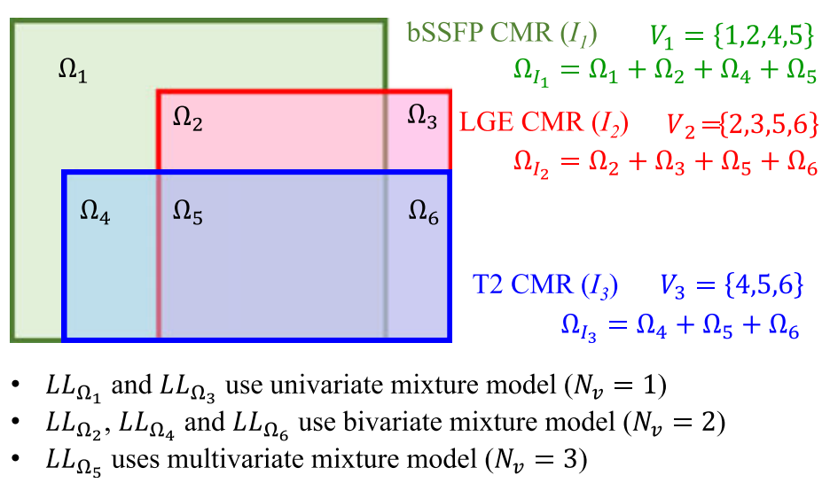
Hetero-Coverage Multi-Modality Images
In medical imaging, data from different acquisitions can generally have different resolutions and coverage of the ROI.
The ROI of the subject is divided into $N_{sr}$ non-overlapping sub-regions $\left\{Ω_{v}:v=1,…,N_{sr}\right\}$ and $Ω=\bigcup_{v=1}^{N_{sr}}{Ω_{v}}$.

Slide 24
Hetero-Coverage Multi-Modality Images
Hetero-coverage log-likelihood: $ℓ\left(I | θ\right)=\sum_{v=1}^{N_{sr}}{\sum_{x∈Ω_{v}}{\ln\left\{\sum_{k∈K}{π_{kx}\prod_{i=1}^{N_{I}}{\sum_{c∈C_{ik}}{τ_{ikc}⋅Φ_{ikc}\left(I_{i}\left(x\right)\right)}}}\right\}}}$
The optimization of the segmentation parameters is similar to the case of congruent data: $P_{kx}^{\left[m+1\right]}=\frac{p\left(I_{v}\left(x\right) | k_{x};θ^{\left[m\right]}\right)π_{kx}^{\left[m\right]}}{\sum_{l∈K}{p\left(I_{v}\left(x\right) | l_{x};θ^{\left[m\right]}\right)π_{lx}^{\left[m\right]}}}$ $τ_{ikc}^{\left[m+1\right]}=\frac{\sum_{x∈Ω_{I_{i}}}{P_{ikcx}^{\left[m+1\right]}}}{\sum_{x∈Ω_{I_{i}}}{\sum_{c∈C_{ik}}{P_{ikcx}^{\left[m+1\right]}}}}$ $μ_{ikc}^{\left[m+1\right]}=\frac{\sum_{x∈Ω_{I_{i}}}{I_{i}\left(x\right)P_{ikcx}^{\left[m+1\right]}}}{\sum_{x∈Ω_{I_{i}}}{P_{ikcx}^{\left[m+1\right]}}}$ ${\left(σ_{ikc}^{2}\right)}^{\left[m+1\right]}=\frac{\sum_{x∈Ω_{I_{i}}}{{\left(I_{i}\left(x\right)−μ_{ikc}^{\left[m+1\right]}\right)}^{2}P_{ikcx}^{\left[m+1\right]}}}{\sum_{x∈Ω_{I_{i}}}{P_{ikcx}^{\left[m+1\right]}}}$

Slide 25
Contents
Introduction & Motivation
Combined segmentation for multi-source images
Simultaneous registration and segmentation
Multivariate mixture model
Problem formulation and representation
Expectation-maximization algorithm
Spatial regularization
Hetero-coverage multi-modality images
Experiment and demonstration
Conclusion

Slide 26
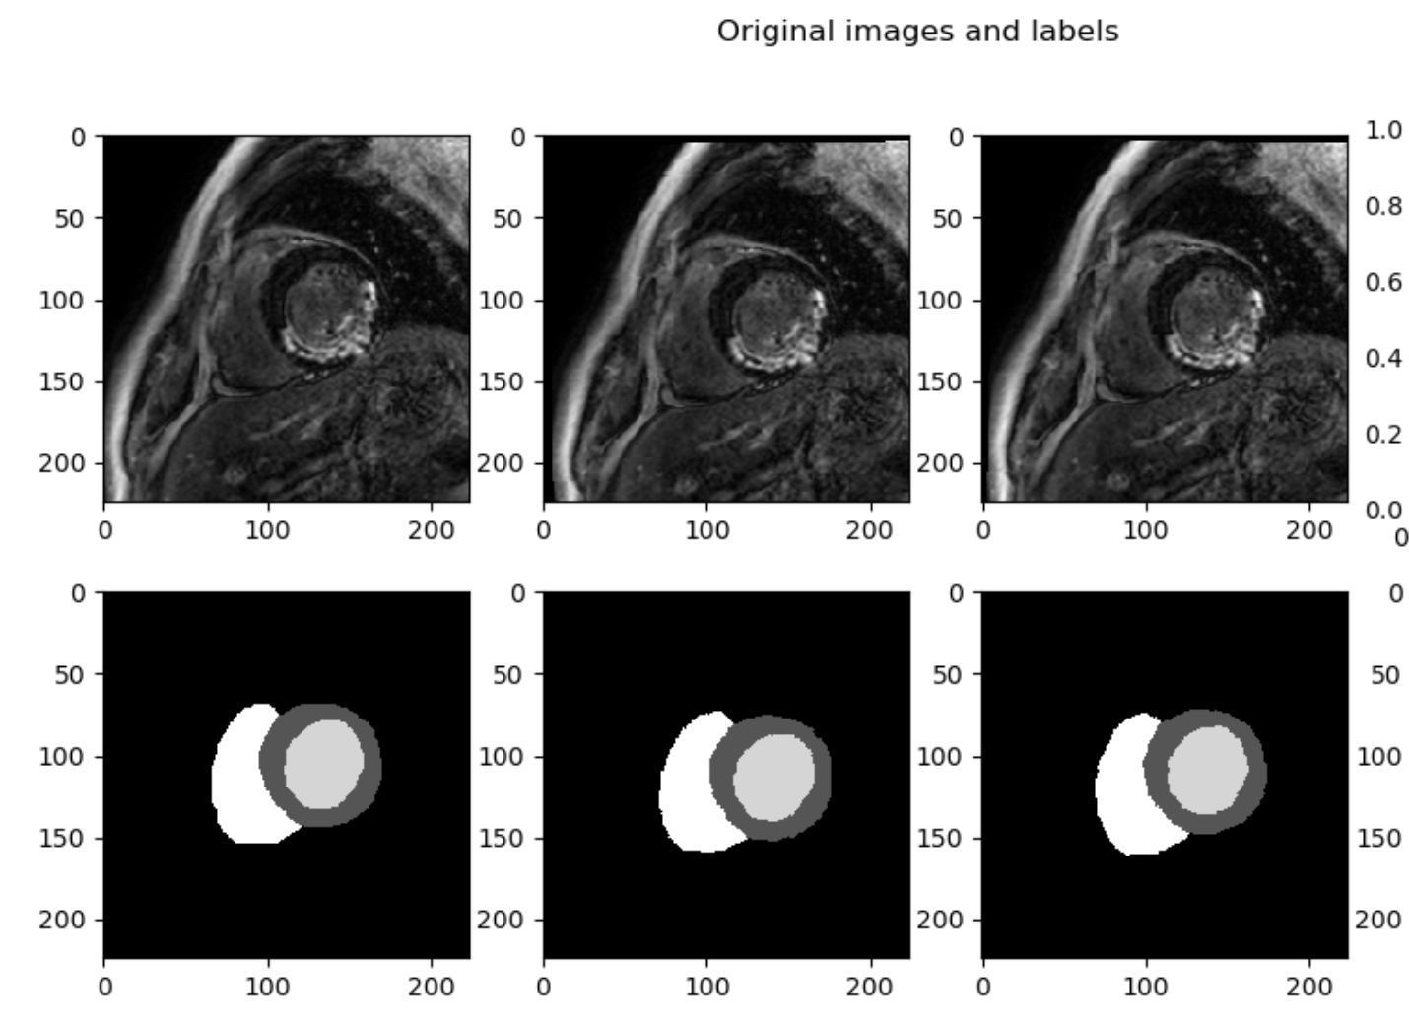
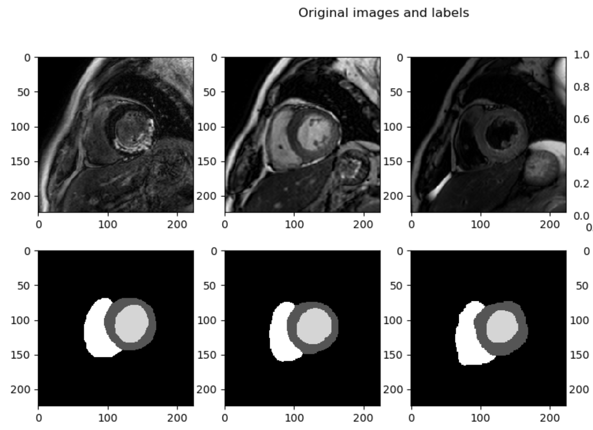
Experiment and demonstration
Data: MSCMR dataset
Experimental setup:
Mono-modality synthetic data from the same image slice
‘patient1_DE_image_slice12’
Intra-patient multi-modality image slices
‘patient1_DE_image_slice12’, ‘patient1_C0_image_slice5’, ‘patient1_T2_image_slice3’
Notes:
Pad velocity field
周围velocity field正则化

Slide 27
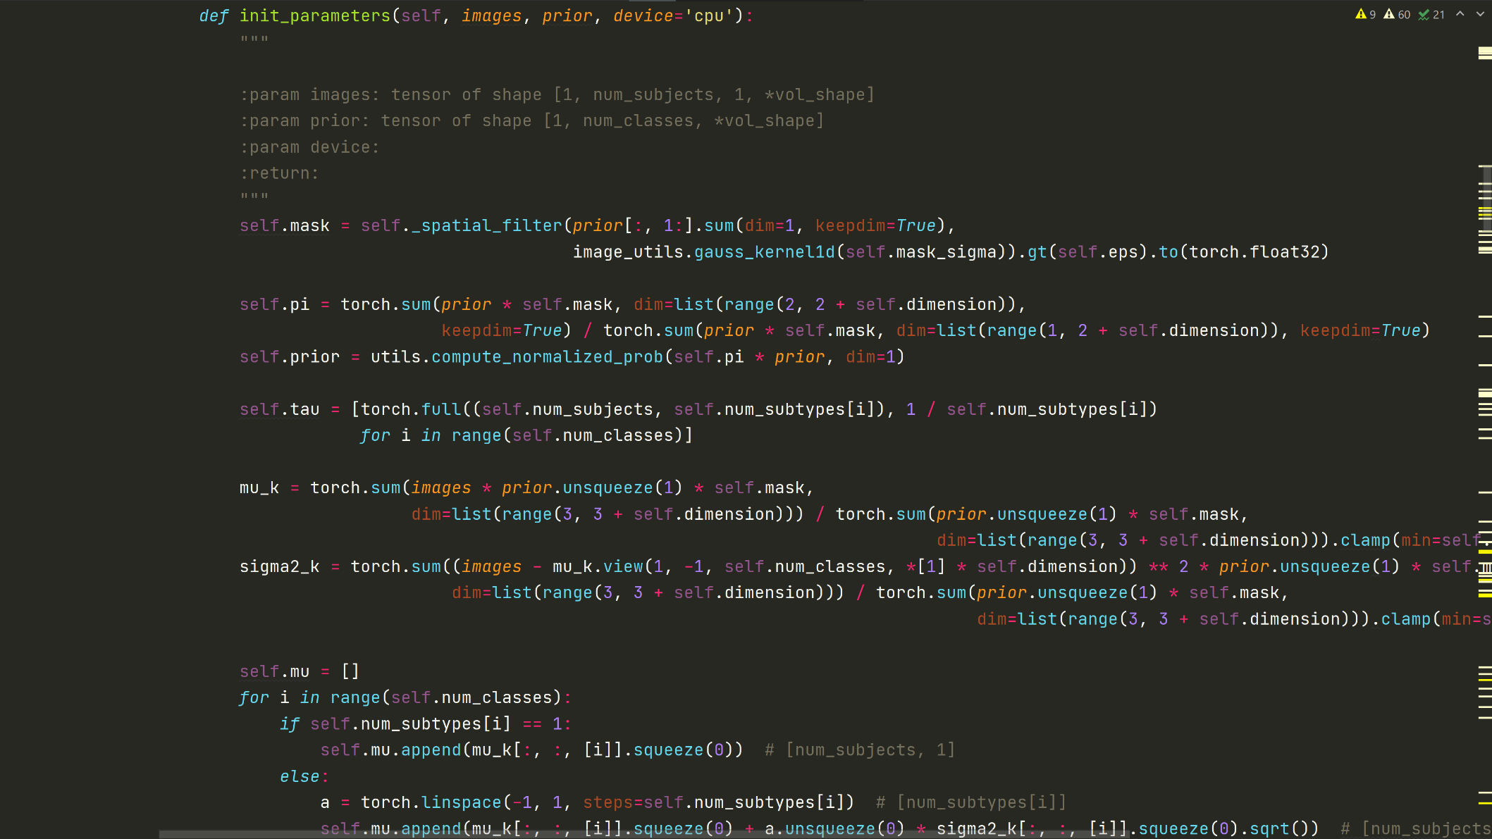
Experiment and demonstration
Initialization

Slide 28
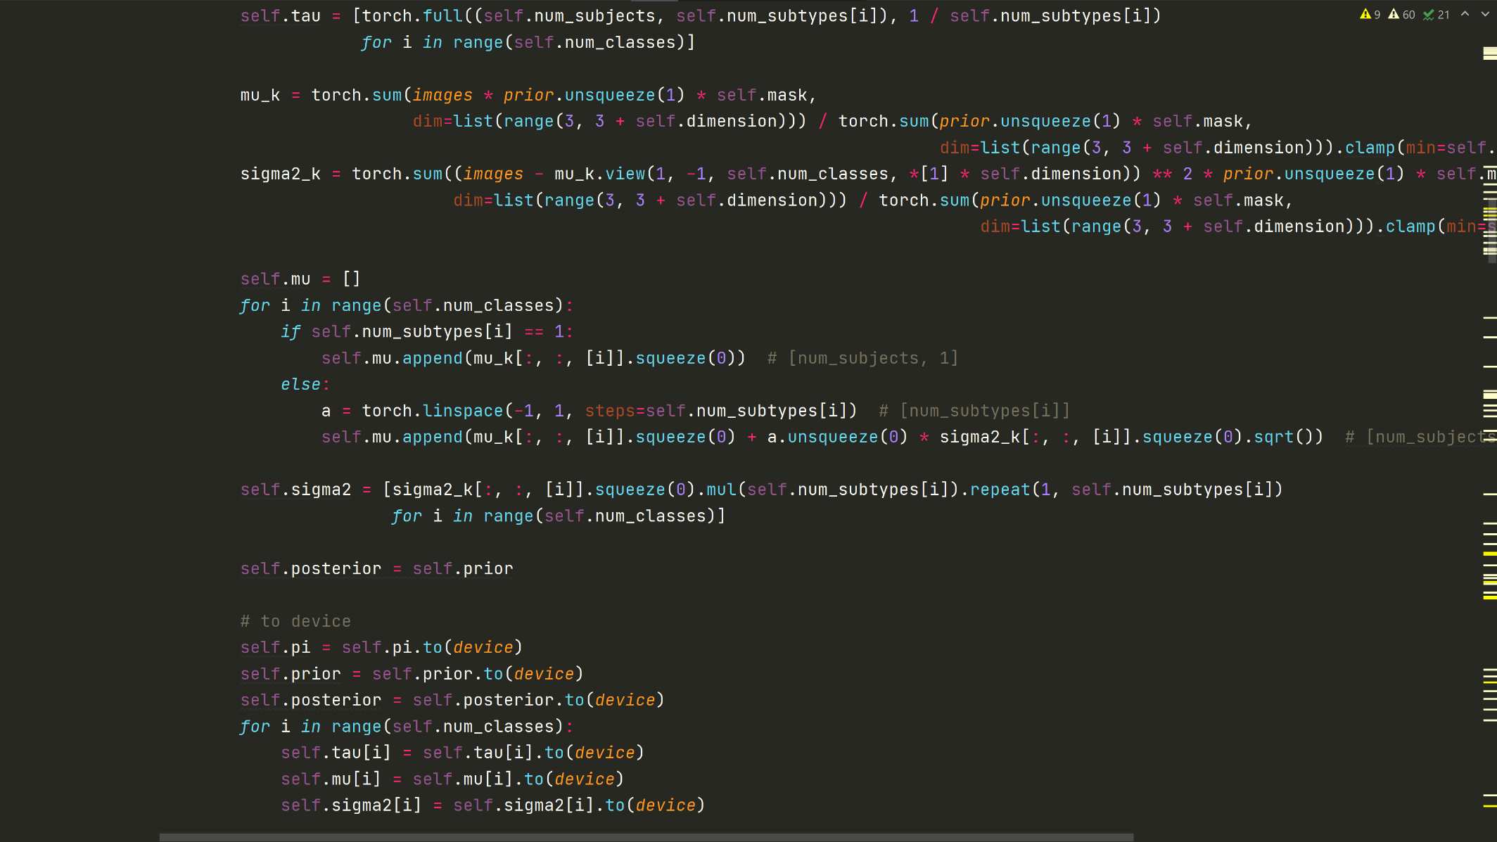
Experiment and demonstration
Initialization

Slide 29
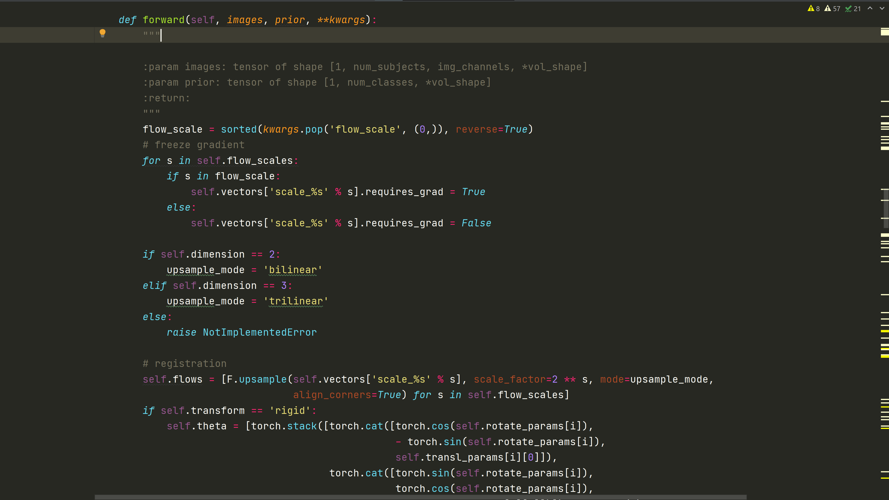
Experiment and demonstration
Forward

Slide 30
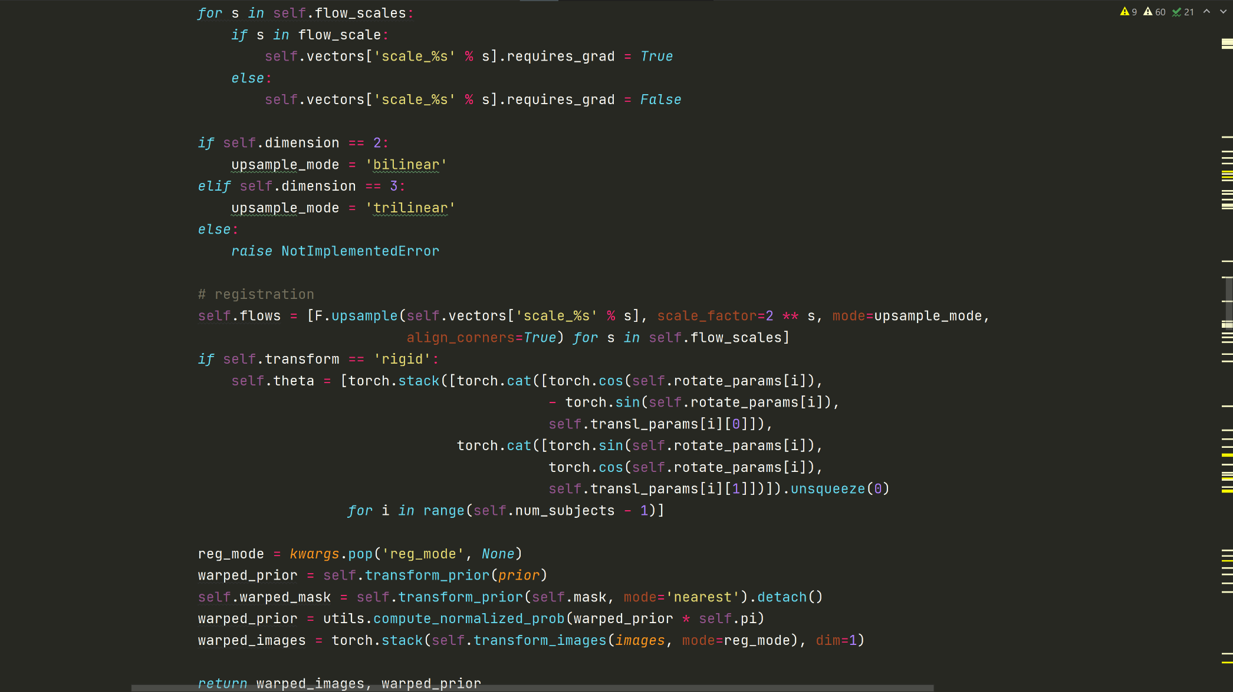
Experiment and demonstration
Forward

Slide 31
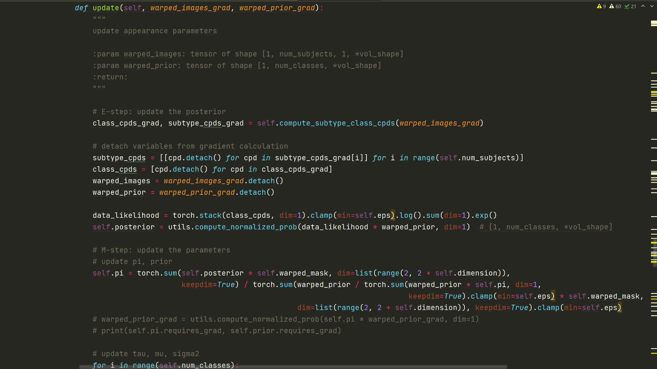
Experiment and demonstration
EM update

Slide 32
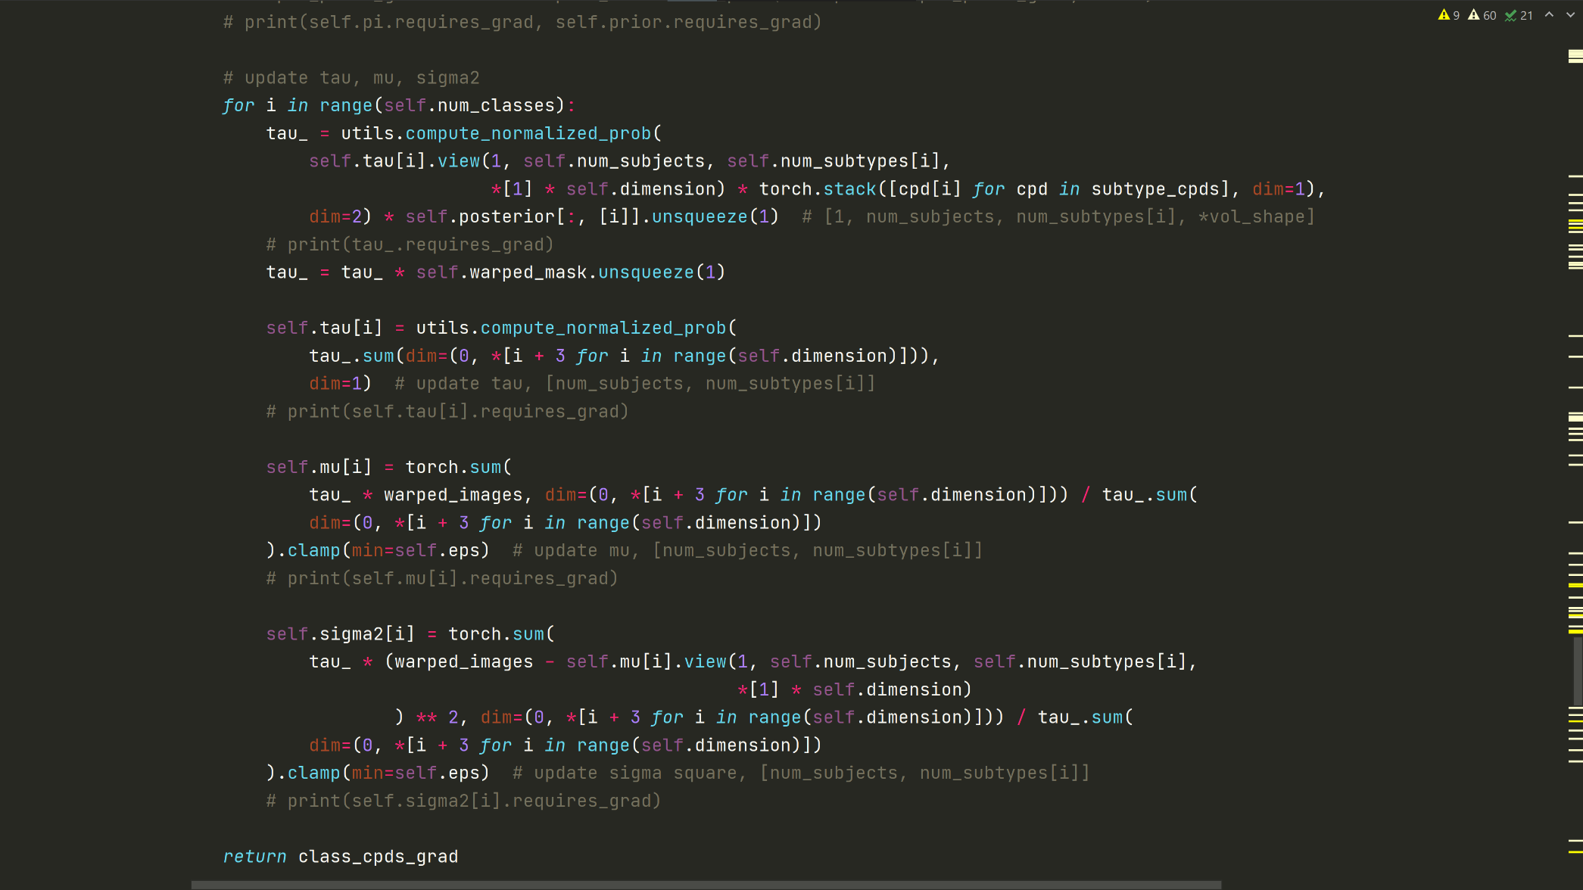
Experiment and demonstration
EM update

Slide 33
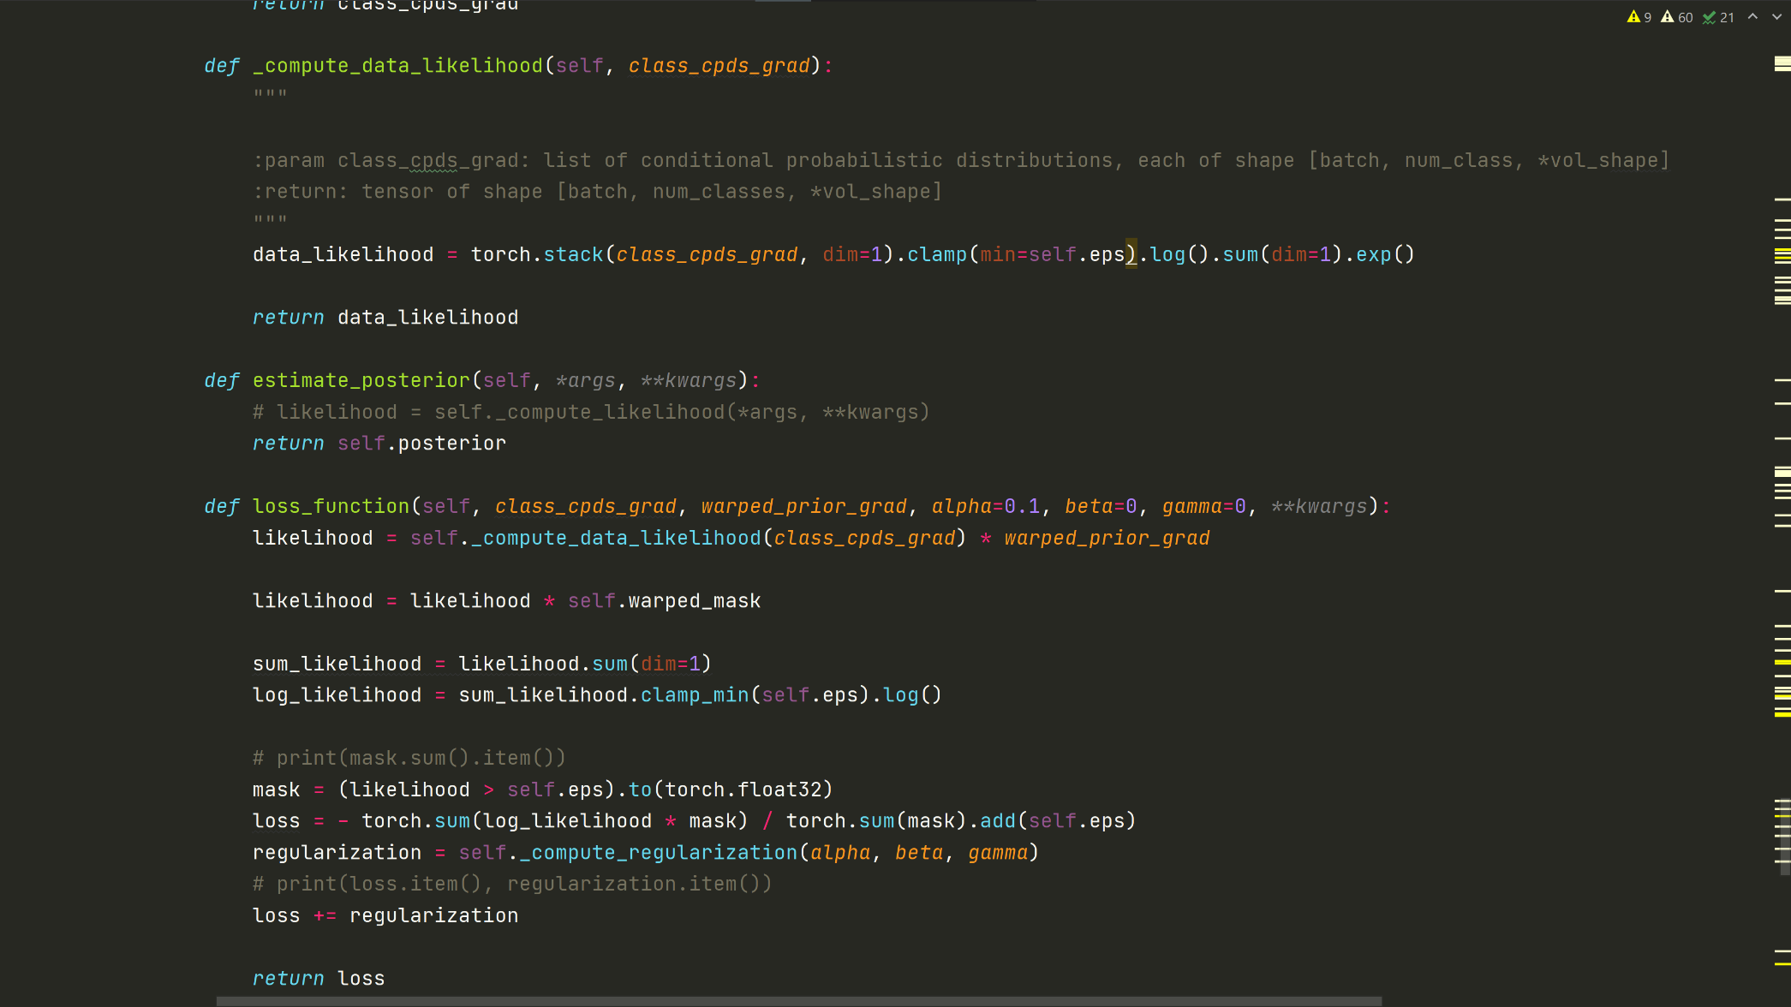
Experiment and demonstration
Likelihood function

Slide 34
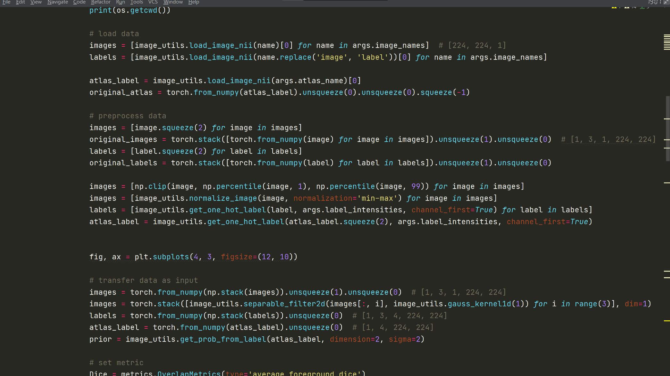
Experiment and demonstration
Data preprocessing:

Slide 35
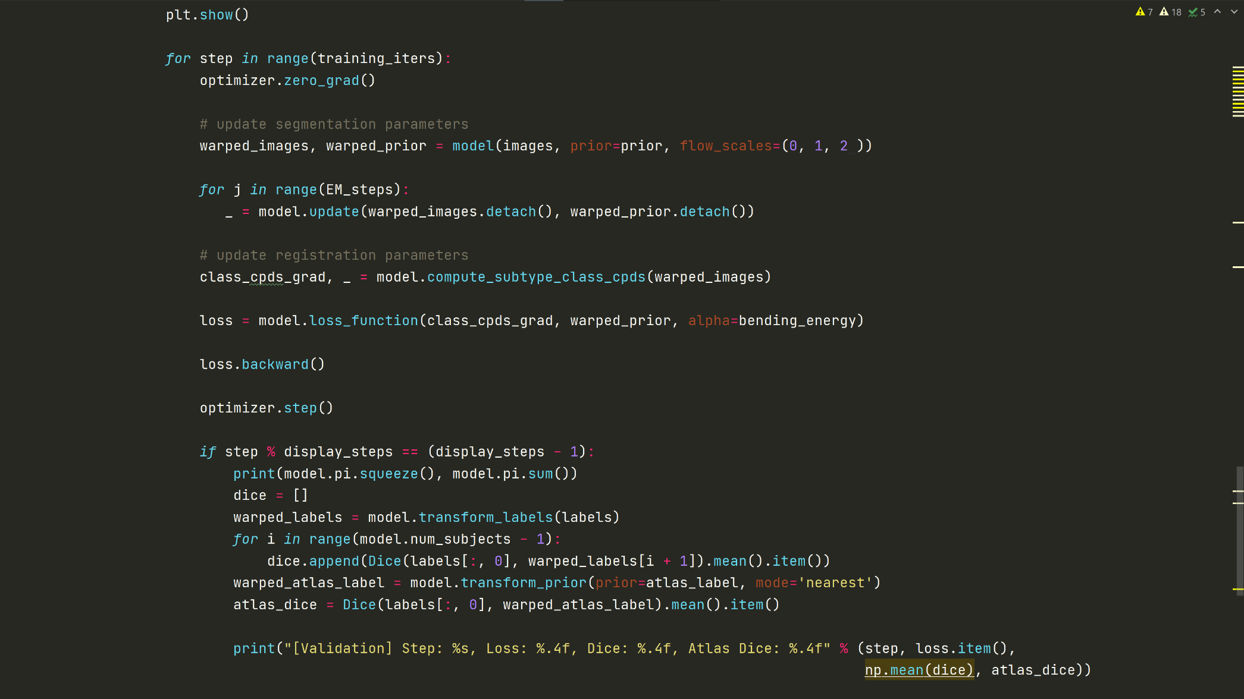
Experiment and demonstration
Optimization

Slide 36
Contents
Introduction & Motivation
Combined segmentation for multi-source images
Simultaneous registration and segmentation
Multivariate mixture model
Problem formulation and representation
Expectation-maximization algorithm
Spatial regularization
Hetero-coverage multi-modality images
Experiment and demonstration
Conclusion

Slide 37
Conclusion
Probabilistic graphical model integrates inference and learning, which combines segmentation and registration in a unified framework.
Generative modelling facilitates combined computing from multivariate images by presuming suitable conditional independences and designating proper data generating distributions.
Further reading:
Zhuang, Xiahai. "Multivariate mixture model for myocardial segmentation combining multi-source images." IEEE transactions on pattern analysis and machine intelligence 41, no. 12 (2019): 2933-2946.
Blaiotta, Claudia, Patrick Freund, M. Jorge Cardoso, and John Ashburner. "Generative diffeomorphic modelling of large MRI data sets for probabilistic template construction." NeuroImage 166 (2018): 117-134.
Bishop, Christopher M. Pattern recognition and machine learning. springer, 2006.
Koller, Daphne, and Nir Friedman. Probabilistic graphical models: principles and techniques. MIT press, 2009.

Slide 38
Thank You ！

